Slide 1
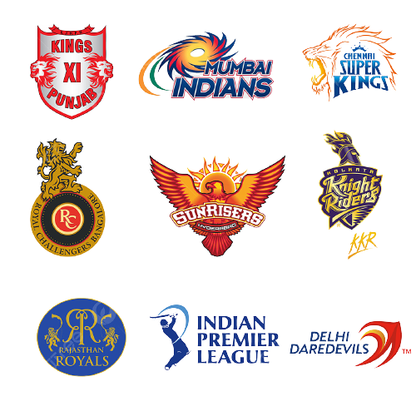
Project title: Indian premier League
Created By : Shashank Mishra
Category : Sports

Slide 2

Hi, everyone! I am Shashank Mishra, a Sports Analyst at The Sparks Foundation. During my routine office work, my boss presented me with an exciting new project. And guess what? It's about the one and only Indian Premier League (IPL)!
I couldn't contain my happiness when I saw the title.
This project involves delving into the dataset and
conducting an Exploratory Data Analysis. I am thrilled about the prospects of uncovering insightful conclusions from the data.

Slide 3



Slide 4
The IPL has captured the hearts of cricket enthusiasts worldwide, and this project provides an extraordinary opportunity to delve deeper into its captivating realm. Through meticulous analysis, I aim to unearth compelling conclusions that will not only enrich our understanding of the game but also ignite our passion for this extraordinary league.
Stay tuned as I delve into the world of IPL, leveraging data analysis to uncover intriguing patterns, player performance trends, team dynamics, and much more. Together, we will unlock the secrets and unveil the hidden stories behind this captivating cricket extravaganza.
Let's embark on this exhilarating project and uncover the wonders that await us in the realm of the Indian Premier League….

Slide 5


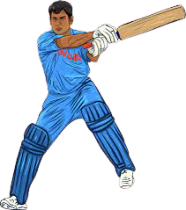

Problem Statement
We have a dataset of IPL (2009-19).
Finding out the most successful teams, players
and factors contributing win or loss of a team.
Suggest teams or players a company should endorse
for its products.

Slide 6
Strategy
Understanding the dataset
Data Cleaning – MS Excel
Exploratory Data Analysis
Data Visualization - Tableau
Conclusions
Summary

Slide 7
Features Definition
Batting Average: The average number of runs scored by a player per dismissal in cricket.
Strike Rate: The number of runs scored by a player per 100 balls faced, indicating the scoring rate.
Wide Runs: Extra runs awarded to the batting team when a bowler delivers a wide ball.
Penalty Runs: Additional runs awarded to the batting team due to a breach of cricket rules by the fielding team.
Batsman Runs: The runs scored by a batsman through their own batting efforts.
Extra Runs: The runs awarded to the batting team through extras, including wides, no balls, and penalty runs.
Total Extras: The total number of extra runs awarded to the batting team.
Bowling Average: The average number of runs conceded by a bowler per wicket taken.
Bowling Strike Rate: The average number of balls bowled by a bowler per wicket taken, indicating effectiveness.
Economy: The average number of runs conceded by a bowler per over bowled, reflecting their bowling efficiency.
Foreign Ground Wins: The number of matches won by a team when playing on grounds other than home country.
Latitude: The angular distance of a location from the equator, determines the geographical positioning of a cricket ground.
Longitude: The angular distance of a location from the prime meridian, used to determine the geographical positioning of a cricket ground.

Slide 8

First look at the original databases: deliveries … matches…

Slide 9

We have transformed the dataset using MS Excel
We did data cleaning that is, handling missing values, finding odd values, etc.
Take a look at the new transformed data files: Win %age… matches… Batting stats… Bowling stats…

Slide 10

Let us move to Tableau for wonderful visualization of the various features of the data…

Slide 11
Conclusions
1. Mumbai Indians and Chennai Super Kings have been the most successful teams in the history of the IPL.
2. Winning the toss has proven to be a crucial factor in determining the outcome of matches.
3. The home ground advantage did not significantly contribute to the teams' success.
4. The ability to perform well on foreign grounds emerged as a major winning factor, with Mumbai Indians and Chennai Super Kings leading the way with 66 wins.
5. Dale Steyn and Sunil Narine have been standout bowlers, known for their exceptional economy rates.
6. Lasith Malinga, Sunil Narine, Harbhajan Singh, Amit Mishra, and R Ashwin have been the most successful bowlers in terms of economy and wickets taken.
7. The dominance of spinners is evident, as four out of the top five bowlers are spin bowlers, which aligns with the typical nature of Indian subcontinent pitches.
8. Virat Kohli, Suresh Raina, and Rohit Sharma have emerged as the leading run-scorers in the tournament.
9. Virat Kohli, Suresh Raina, MS Dhoni, David Warner, and Chris Gayle have established themselves as the top five batsmen in terms of overall stats, including runs and strike rate.

Slide 12



Summary
We utilized MS Excel and Tableau to conduct a comprehensive analysis and visualization of this remarkable project.
After thorough examination, it was determined that toss outcomes and foreign ground wins emerged as the most influential factors in achieving victory.
The teams that exhibited the
highest level of success were:

Slide 13
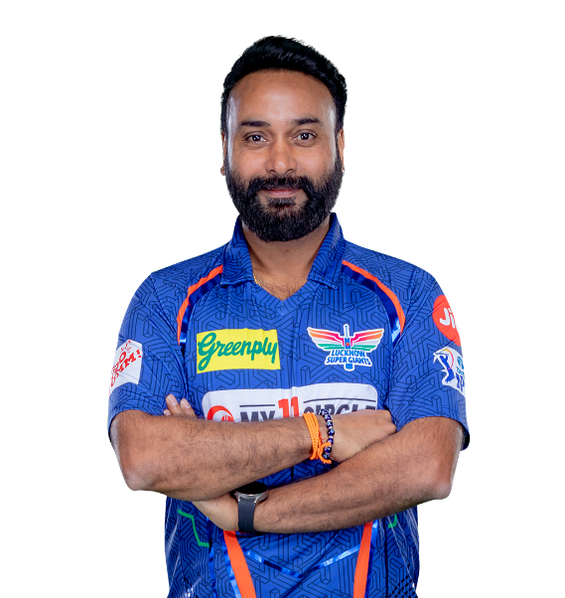
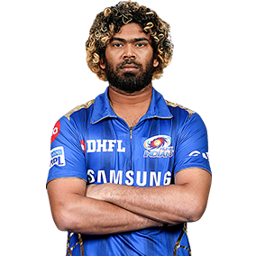
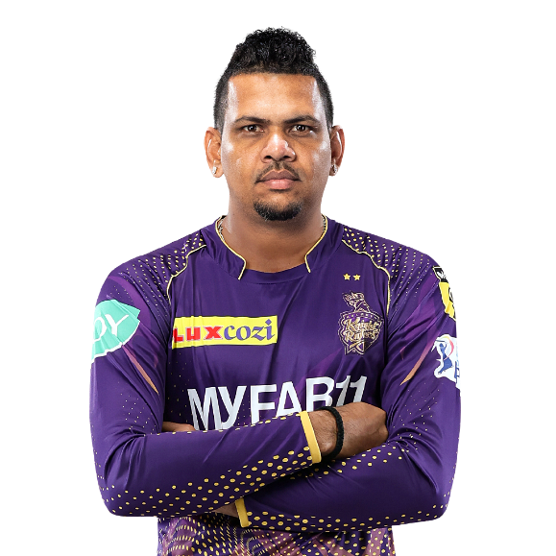
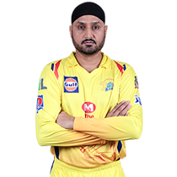
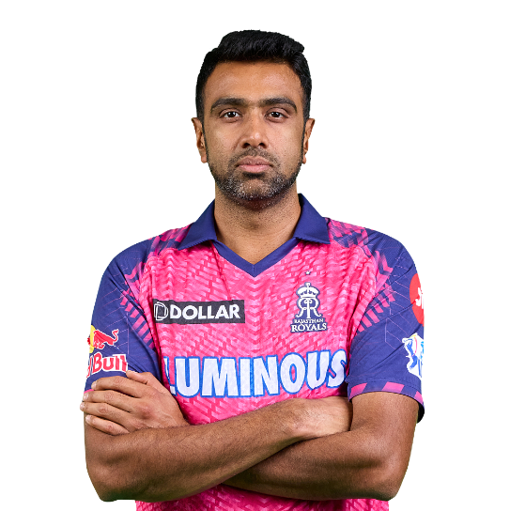
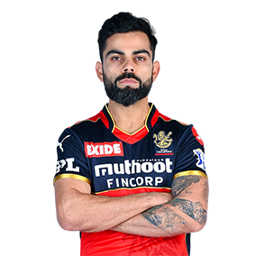

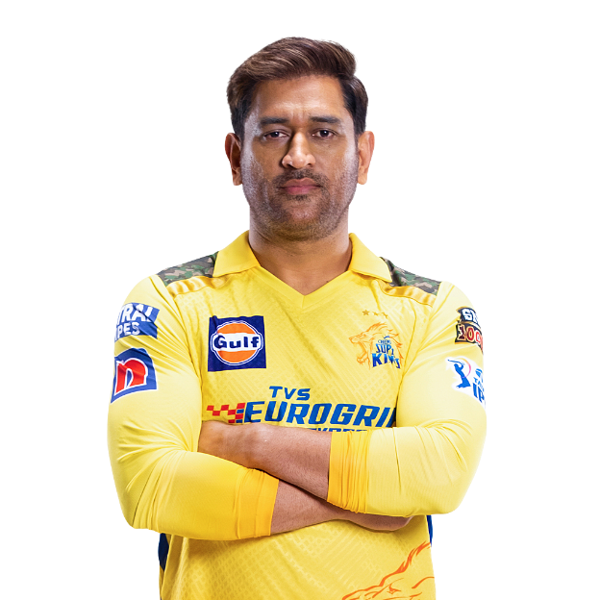
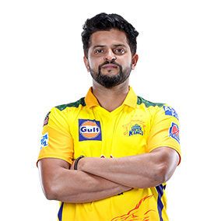

Summary
Most successful bowlers: Lasith Malinga, Sunil Narine, Harbhajan Singh, Amit Mishra & R Ashwin
Most Successful batsman: Virat Kohli, David Warner, MS Dhoni, Suresh Raina & Chris Gayle

Slide 14


Summary
Suggested teams for product endorsements:
Suggested players for product endorsement (*popularity has been also considered in decision): Virat Kohli, Suresh Raina, MS Dhoni, R Ashwin & Chris Gayle

Slide 15


